Slide 1
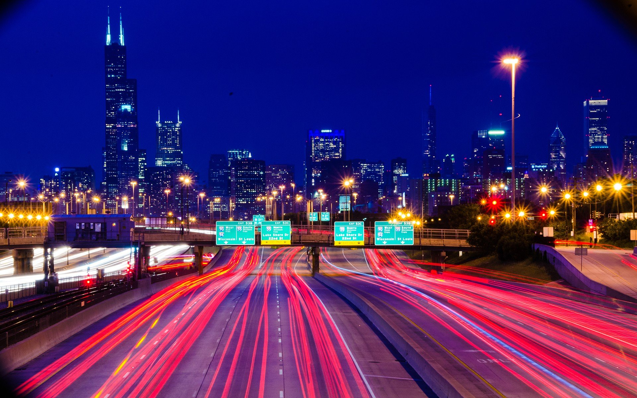
Determining Car Accident Severity
Sarthak Aggarwal

Slide 2
Agenda
INTRODUCTION
DATA
METHODOLOGY
RESULTS
DISCUSSION
CONCLUSION

Slide 3
INTRODUCTION
Question: How to determine accident severity (1 or 2) based on different variables in the dataset such as road conditions, collision type, weather, incident time, and vehicle conditions?
Audience: Traffic Police and Marketing Campaigns
Goal: Interpret & Analyze real-time data to help devise better mitigation strategy to reduce traffic collisions and subsequently save

Slide 4
DATA
Collision data available from Seattle Department of Transport
Contains 37 attributes and more than 19000+ cases reported
Timeframe covered: 2004 to 2020
Attributes include Location, Address Type, Collision Type, Incident Time, Road ,Lighting , weather conditions, etc.

Slide 5
METHODOLOGY
Data Cleaning:
Excluded: geographic information, drop non-numeric values, empty columns and nominal data which didn’t seem to impact the severity
Included: Address Type, Weather, Road Conditions, Collision Type, Light Conditions, Day of the Week
Data Pre-processing: Feature scaling
Data Preparation:
One hot-encoding translation of variables to analyze binary impact and help in classification

Slide 6
TECHNIQUES
Deployed supervised Machine Learning using Sci-kit learning and Pandas in Python
K-Nearest Neighbors
Decision Tree
Support Vector Machine
Logistic Regression

Slide 7
RESULTS
Used 80:20 ratio for training : testing to train the model comprehensively and increase its robustness for fitting of the analysis
Cross Validation done using k folds CV for K Nearest Neighbor to ensure that the overfitting or underfitting of the model doesn’t occur
Based on accuracy evaluation on test size on all data, logistic regression seems the fastest algorithm with 70% + accuracy
Algorithm | Jaccard Index | F1-score | LogLoss
K Nearest Neighbour | 0.73 | 0.70 | NA
Decision Tree | 0.75 | 0.69 | NA
Support Vector Machine | 0.75 | 0.69 | NA
Logistic Regression | 0.75 | 0.69 | 0.49

Slide 8
DISCUSSION
70%+ accuracy achieved by ML techniques in predicting severity of an accident in the future
Conditions/Parameters that minimize the risk of an accident
Dry roads
Good lighting
Sunny weather
Scope for further Improvement
Training on more data could allow for improving data model precision and reduce sensitivity further

Slide 9
CONCLUSION
Machine Learning Algorithms can help determine the severity of the accident in real-time
75% accuracy with supervised learning based predictive model based on logistic regression
Allows better public safety
Opportunity to improve analysis using strong, more efficient data analysis software and exploring the option of bringing geospatial data

Slide 10
‘Alert Today – Alive Tomorrow’
Thank You

